Slide 1
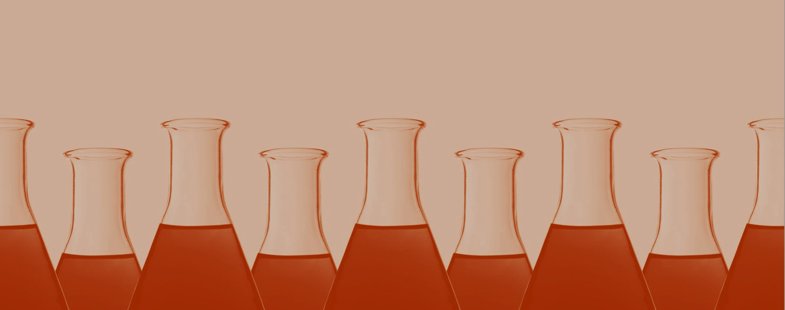
Physics-informed generative models for unsupervised discovery of phase transitions

Slide 2
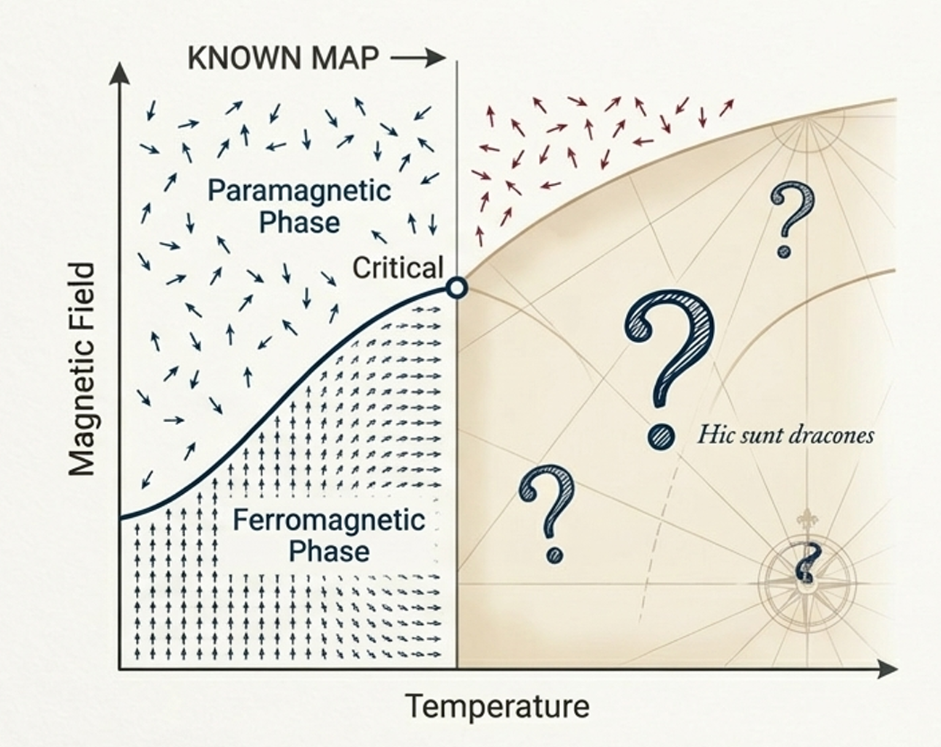
Background
The science behind the project
Phase transitions :
Why do they fail?
1. Analytical solutions → only a few simple models can be solved exactly
2. Monte Carlo simulations → powerful, but expensive and sometimes blind to unexpected phases
3. Exact diagonalization → works only for tiny quantum systems
Hence, they are work only for overly simple models, become too computationally expensive, or cannot scale beyond tiny quantum system
Notes:
They tell us when materials change behaviour — become magnetic, superconducting, ordered, disordered, etc. Analytical solutions → only a few simple models can be solved exactly
Monte Carlo simulations → powerful, but expensive and sometimes blind to unexpected phases
Exact diagonalization → works only for tiny quantum systems

Slide 3
Background
Phase transitions are one of the foundations of materials science.
Traditional tools :
Analytical solution, Monte carols Simulations, Extract Diagonalization
Why do they fail?
1. Analytical solutions → only a few simple models can be solved exactly
2. Monte Carlo simulations → powerful, but expensive and sometimes blind to unexpected phases
3. Exact diagonalization → works only for tiny quantum systems
Hence, they are work only for overly simple models, become too computationally expensive, or cannot scale beyond tiny quantum system
Notes:
They tell us when materials change behaviour — become magnetic, superconducting, ordered, disordered, etc. Analytical solutions → only a few simple models can be solved exactly
Monte Carlo simulations → powerful, but expensive and sometimes blind to unexpected phases
Exact diagonalization → works only for tiny quantum systems

Slide 4
The Problem Statement
“No reliable automated system exists that can discover new phases from unlabeled physical observables with calibrated uncertainty.”

Slide 5
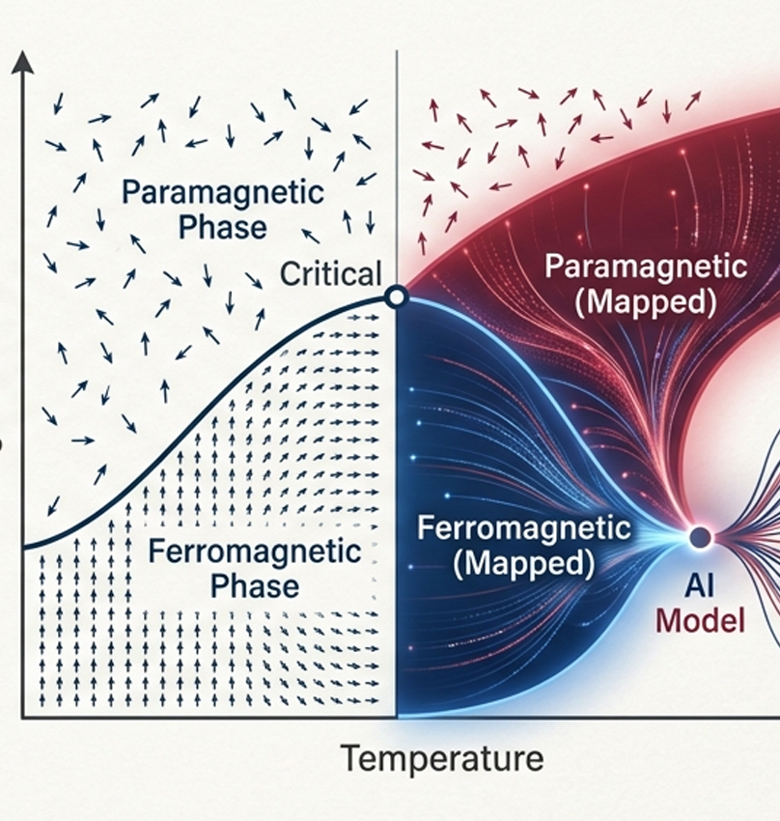
Proposed Solution

Slide 6
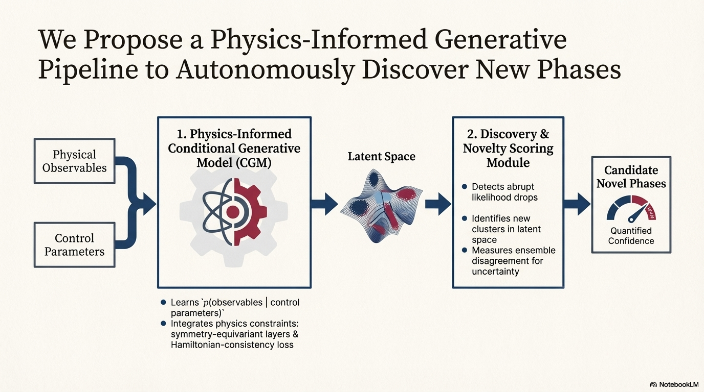
Notes:
ML gives physics a new tool: the ability to scan complex data and automatically spot when a material behaves in a way that suggests a new, previously unknown phase.

Slide 7
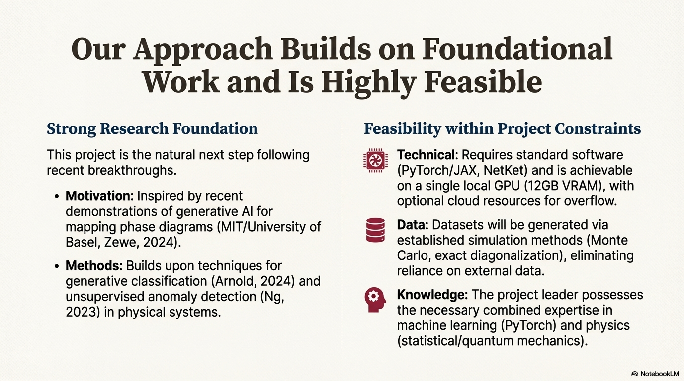

Slide 8
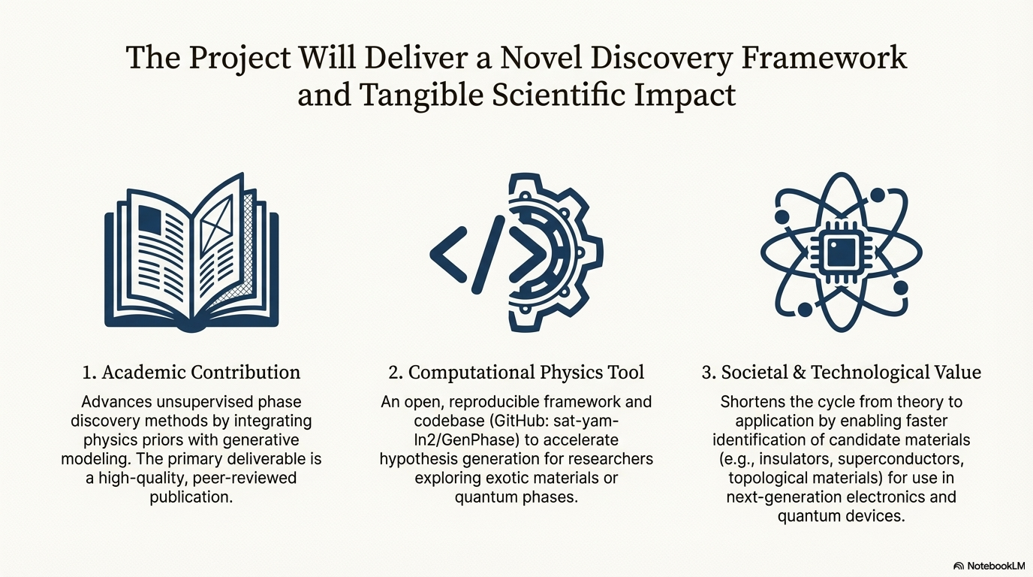

Slide 9
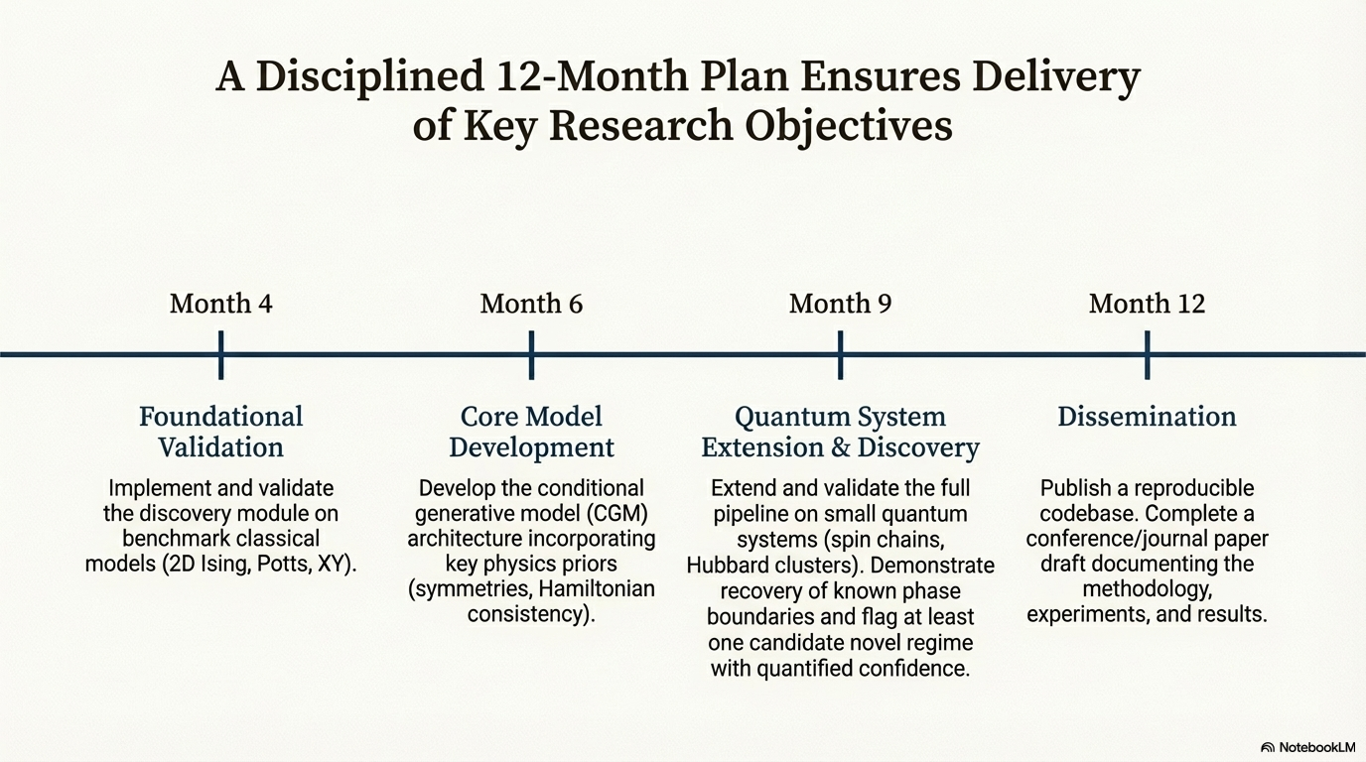

Slide 10

Thank you
Notes:
Why me?
This is wh I am into ai , ai will not Motivated , my philosophy for life aligns with this
We have one life,

